Slide 1


In Snake Venom Research
Presented by : Anuththara Gamage

Slide 2

Objectives
Define AlphaFold.
Explain its functioning.
Outline how it achieves accurate protein structure predictions at an atomic level.
How to use it.
Discuss the application of AlphaFold in snake venom research.

Slide 3
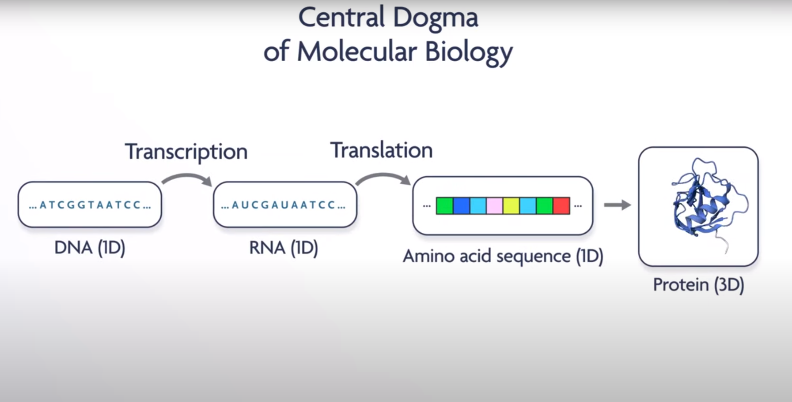

Slide 4
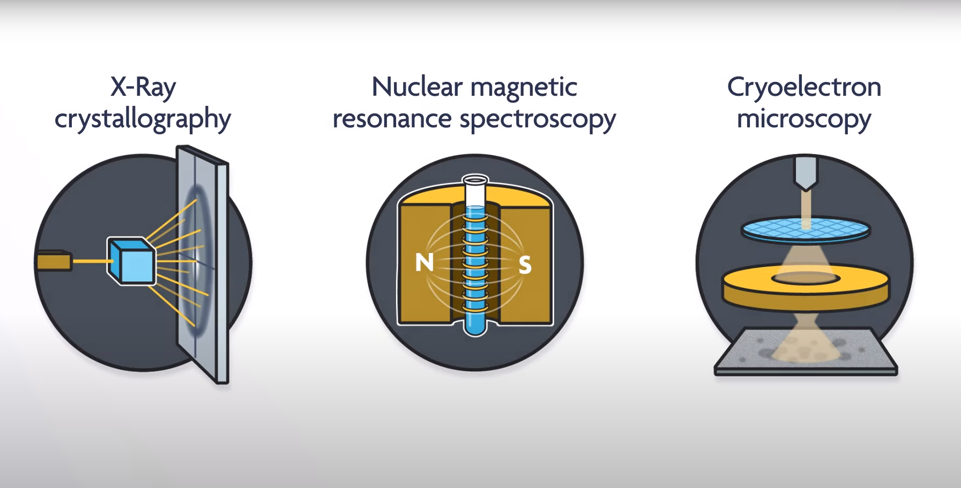

Slide 5
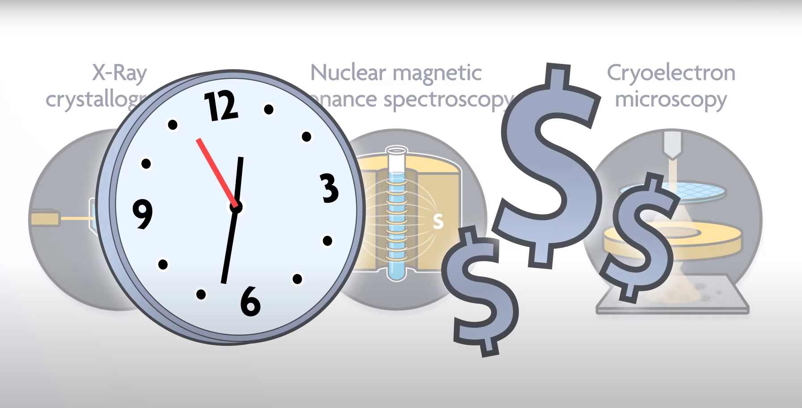

Slide 6
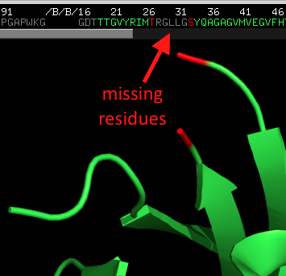

Slide 7

DeepMind Technologies Limited, doing business as Google DeepMind, is a British-American artificial intelligence research laboratory which serves as a subsidiary of Google.

Slide 8


Slide 9
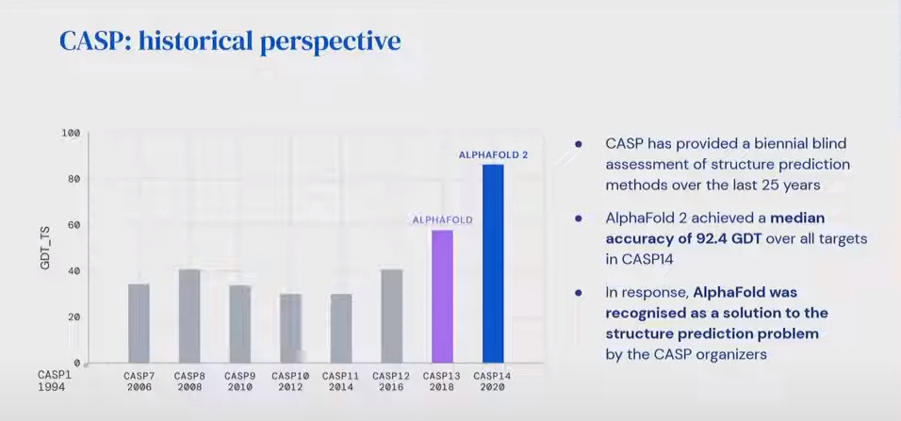
Critical assessment of structure prediction

Slide 10
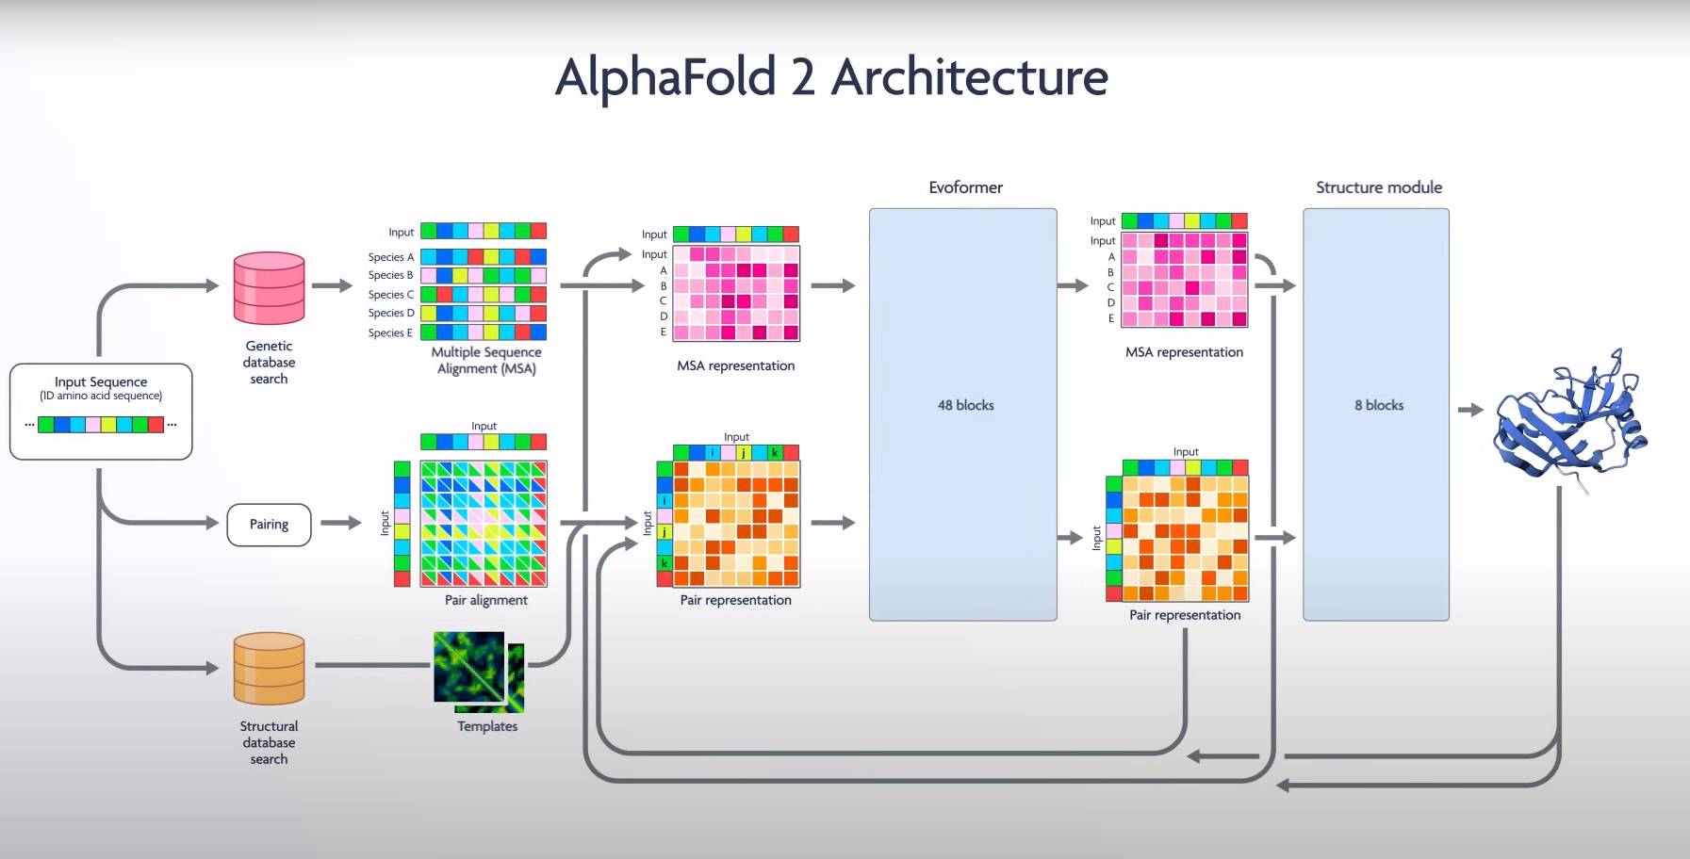

Slide 11
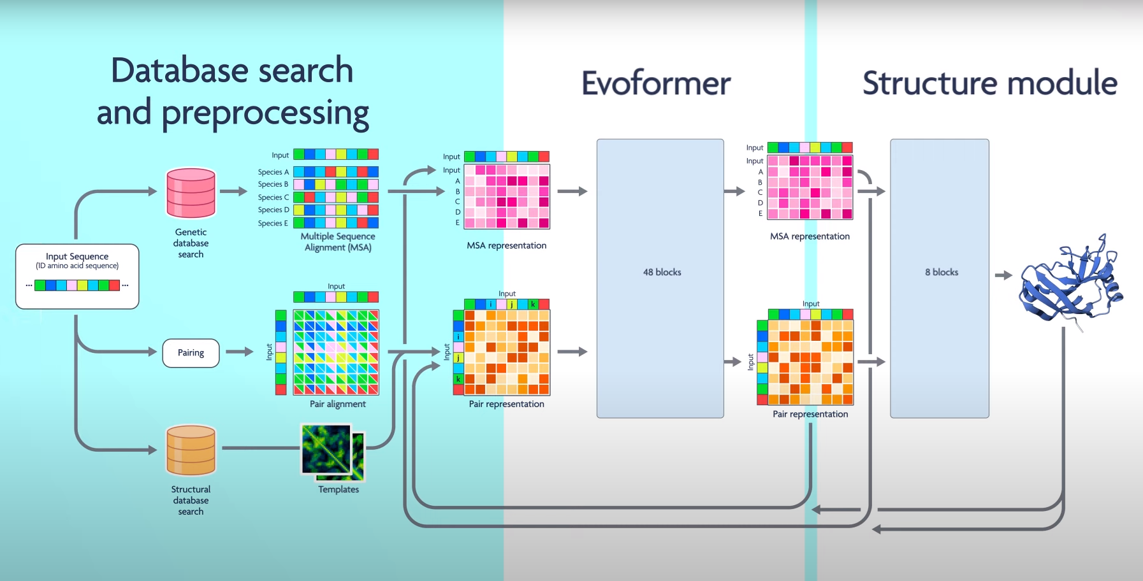

Slide 12
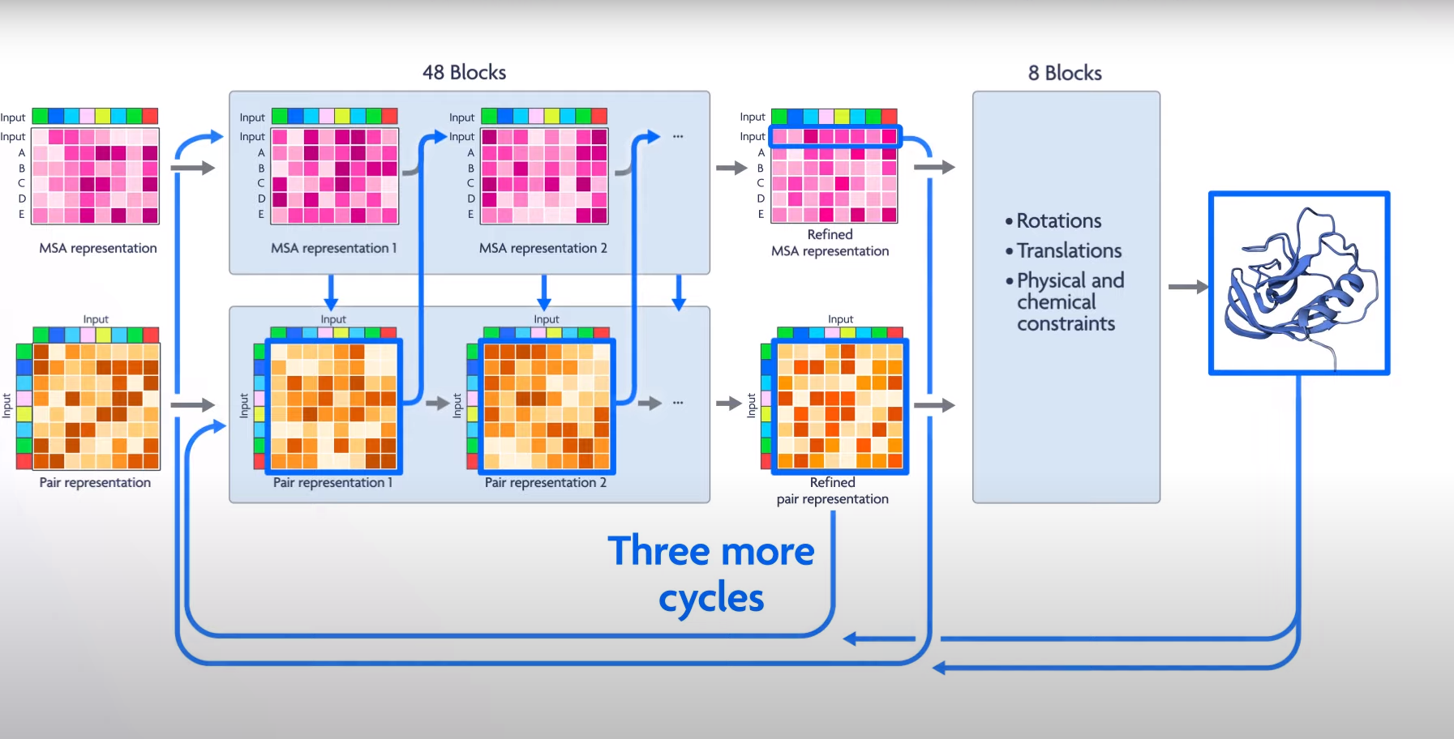

Slide 13
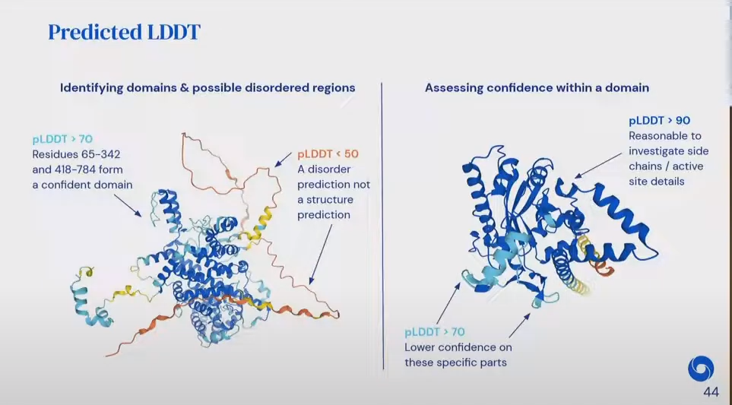
local Distance Difference Test

Slide 14
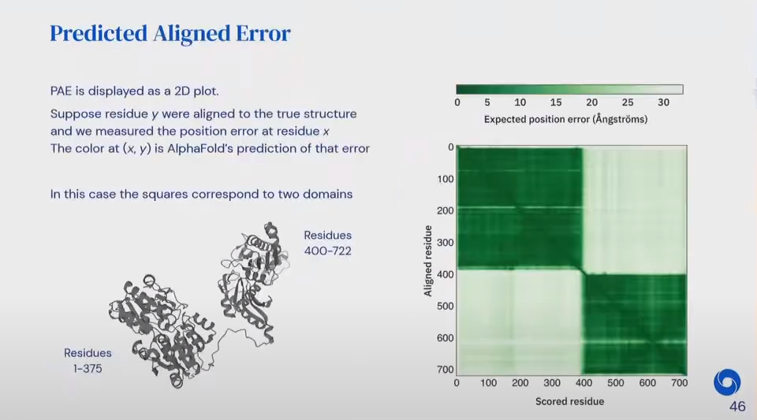

Slide 15
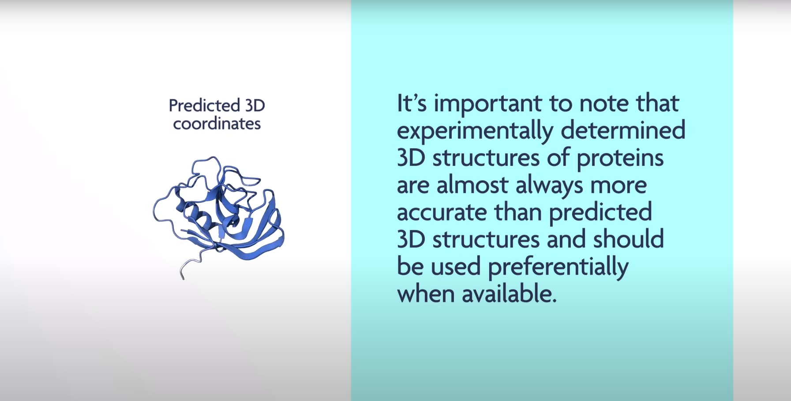

Slide 16
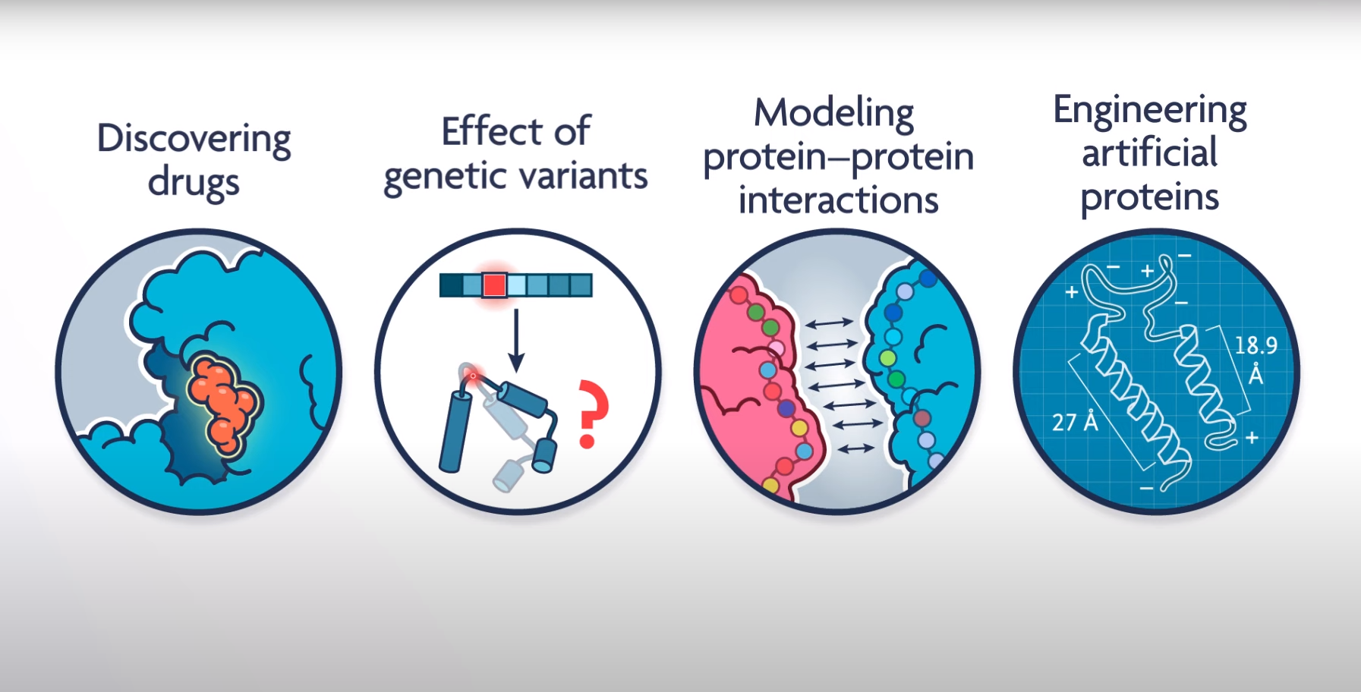

Slide 17

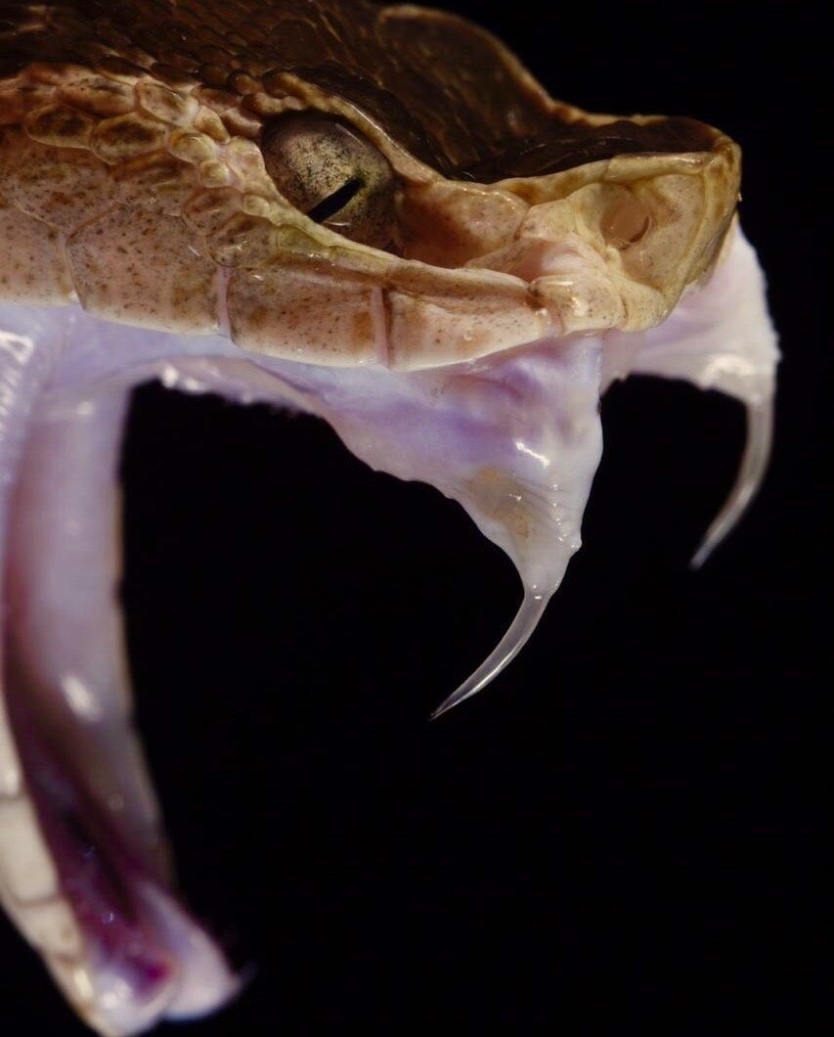
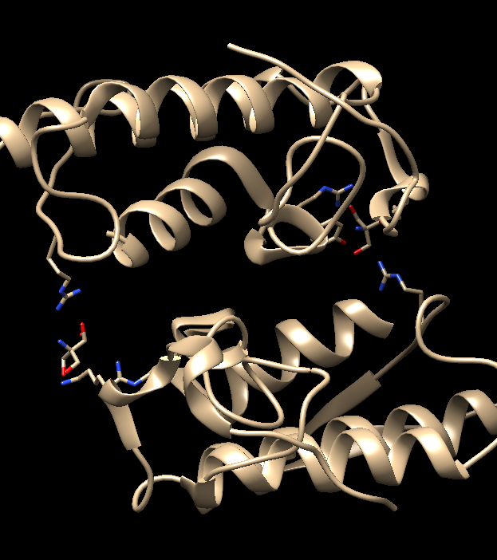
Crystal Structure of MT-I isolated from Bothrops asper venom

Slide 18
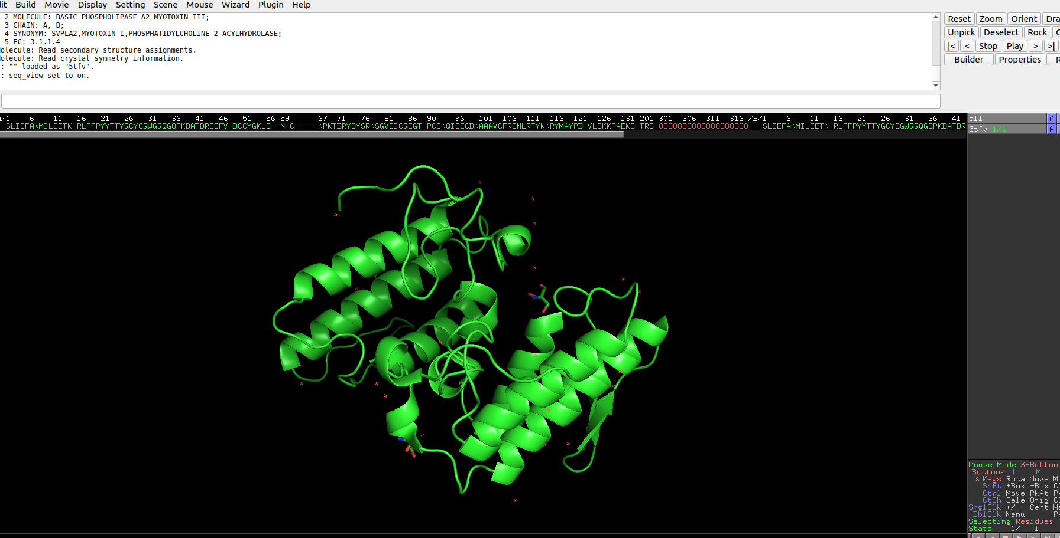
Missing Residues in pdb file

Slide 19
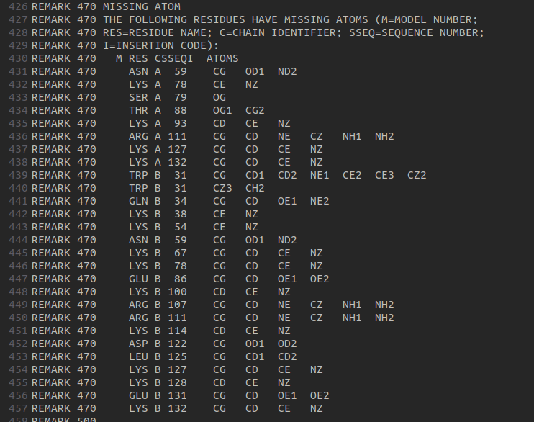
Missing Residues

Slide 20

AlphaFold protein structure data base collaborated with EMBL.
https://alphafold.ebi.ac.uk/
2. AlphaFold Colab
https://colab.research.google.com/github/deepmind/alphafold/blob/main/notebooks/AlphaFold.ipynb#scrollTo=XUo6foMQxwS23. AlphaFold Full Version(Open Source)
https://github.com/google-deepmind/alphafold

Slide 21
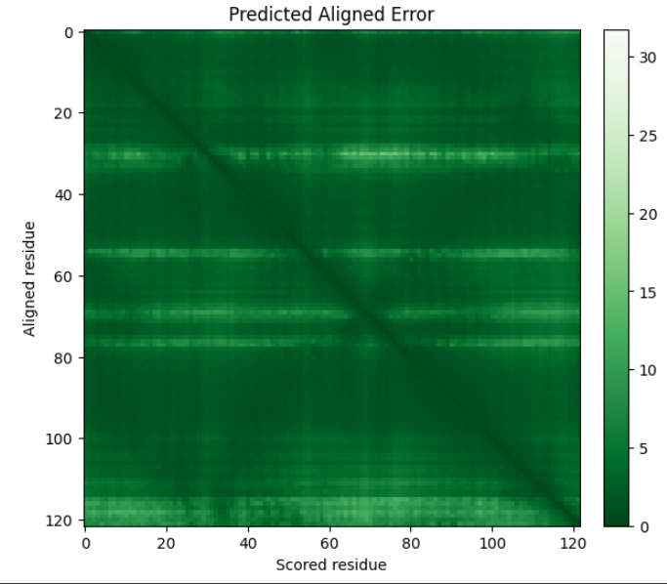
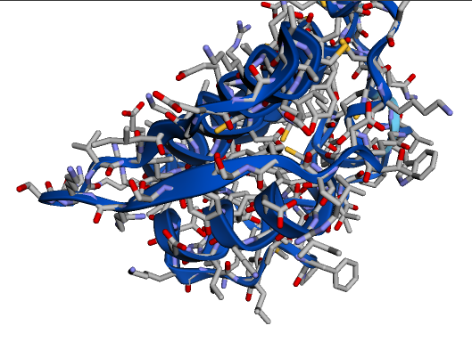
PAE
Ran on AlphaFold Colab
LLTD

Slide 22
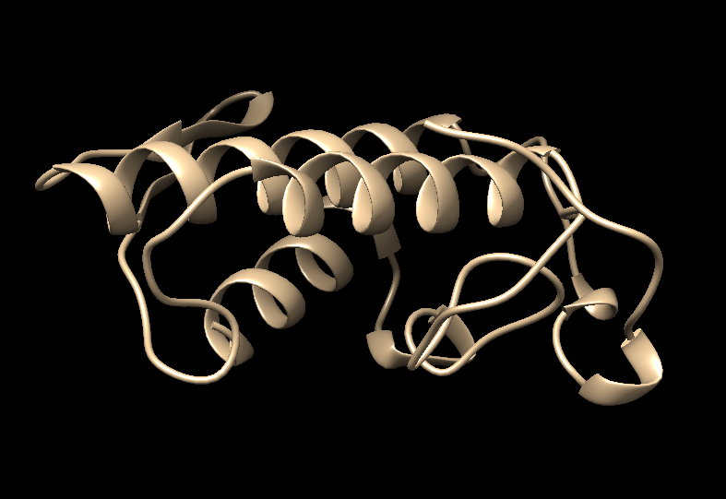
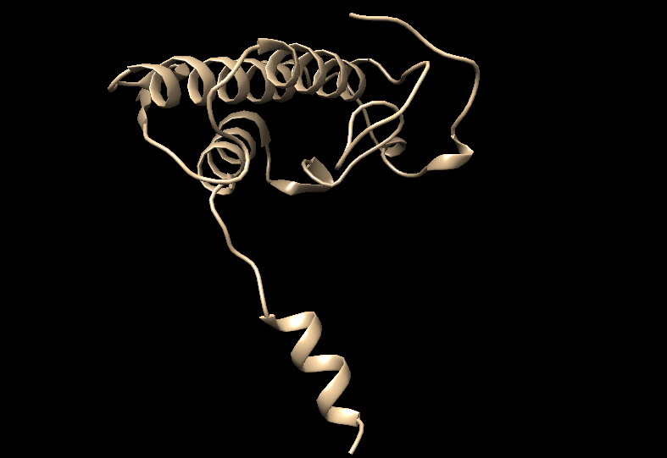
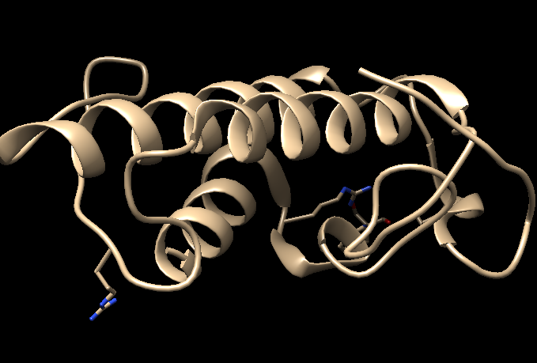
AlphaFold Colab
Original structure
AlphaFold protein structure data base collaborated with EMBL

Slide 23
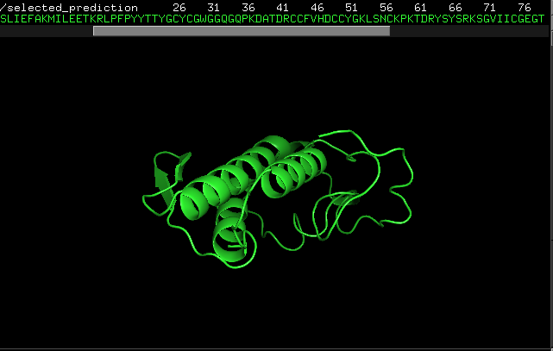
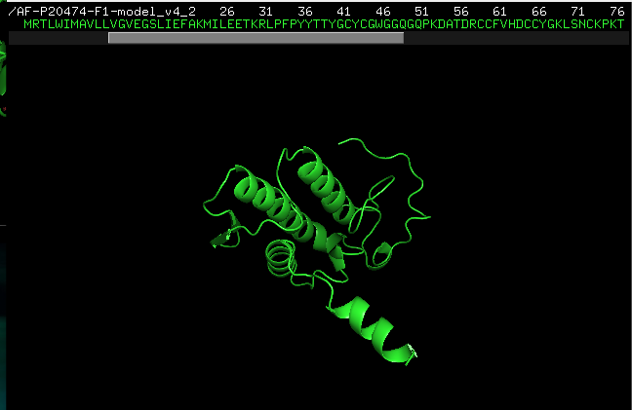
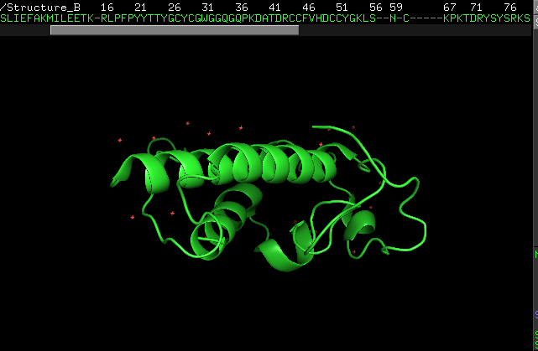
AlphaFold Colab
Original structure
AlphaFold protein structure data base collaborated with EMBL

Slide 24
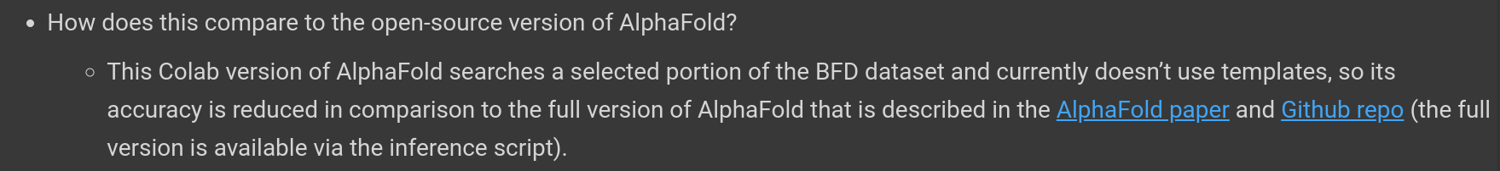

Slide 25
References :
https://www.nature.com/articles/s41586-021-03819-2
https://youtu.be/Uv3FN81coLg?si=NvLBafSNa3GAu-GZ
https://youtu.be/7q8Uw3rmXyE?si=SF_k_BQ9sS1Nua3p
https://youtu.be/tTN0MM2CQLU?si=MdsRkBx0pv-paNID
https://youtu.be/tTN0MM2CQLU?si=205HUbOIzRbvvGXI

Slide 26

THANK YOU

